Slide 1

Root Words List 2
Week of November 18 – 22
2013

Slide 2


CHROM
color

Slide 3

DEM
people

Slide 4

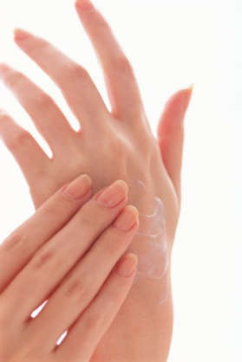
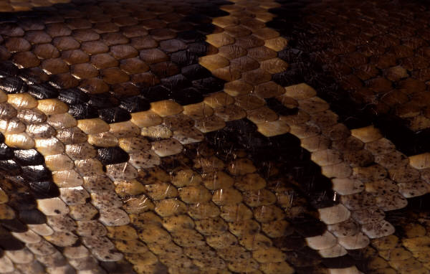
DERM
skin

Slide 5

FED, FID
trust, faith

Slide 6
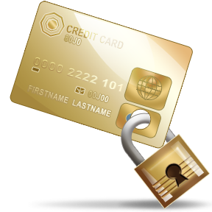
FIN
end, limit

Slide 7
FLU, FLO
flow

Slide 8
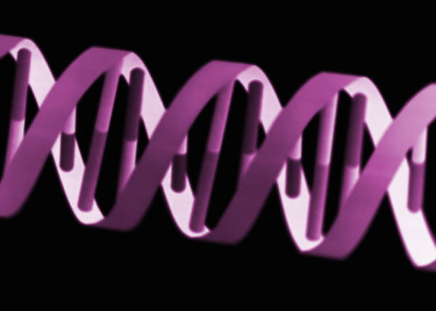


GEN
race, kind, birth

Slide 9
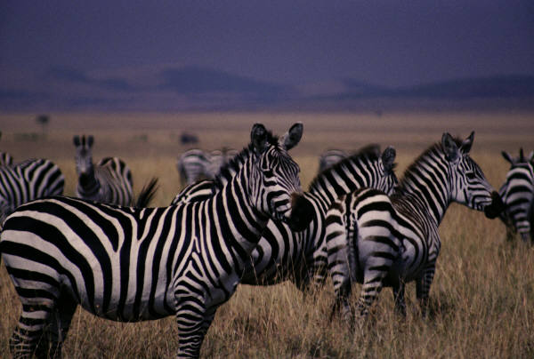
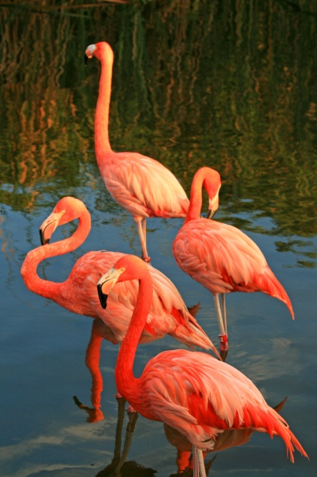
GREG
group, flock, herd

Slide 10



MIS, MIT
send

Slide 11

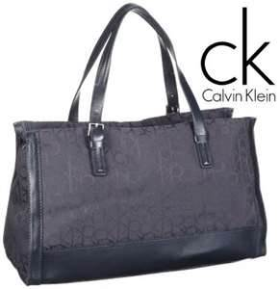

PORT
carry

